Slide 1

SUMMER INTERNSHIP/TRAINING on NEURAL NETWORKs
Hindustan College of Science and Technology, Farah, Mathura
Department of Information Technology
Project Title:
Handwritten Digits by FNN(FEED-FORWARD NEURAL NETWORK)
Company Name:
Udemy
Duration
(No. of Hrs/Weeks): 8 weeks

Slide 2
AGENDA
Introduction
Training Certificate
Literature Survey
(Language/tools learned during training) in detail
Introduction to Project
Why this project has been chosen?
Project Modules
Feasibility Study
Requirement specification
System design
Snapshot of project modules and outcomes

Slide 3

INTRODUCTION
Udemy is a leading destination for online courses that empowers you to grow professionally and personally.
So I select the course of my field of interest Neural Networks.
It also cultivate a learning culture at our professional site .
Train us on the latest in-demand skills.
Notes:
Picture from::::::: https://www.google.com/url?sa=i&url=https%3A%2F%2Fwww.udemy.com%2Fjoin%2Flogin-popup%2F&psig=AOvVaw2HjLEvBHzNqpzL2D6cC3NG&ust=1668102113647000&source=images&cd=vfe&ved=0CA0QjRxqFwoTCNC0zeHSofsCFQAAAAAdAAAAABAD

Slide 4
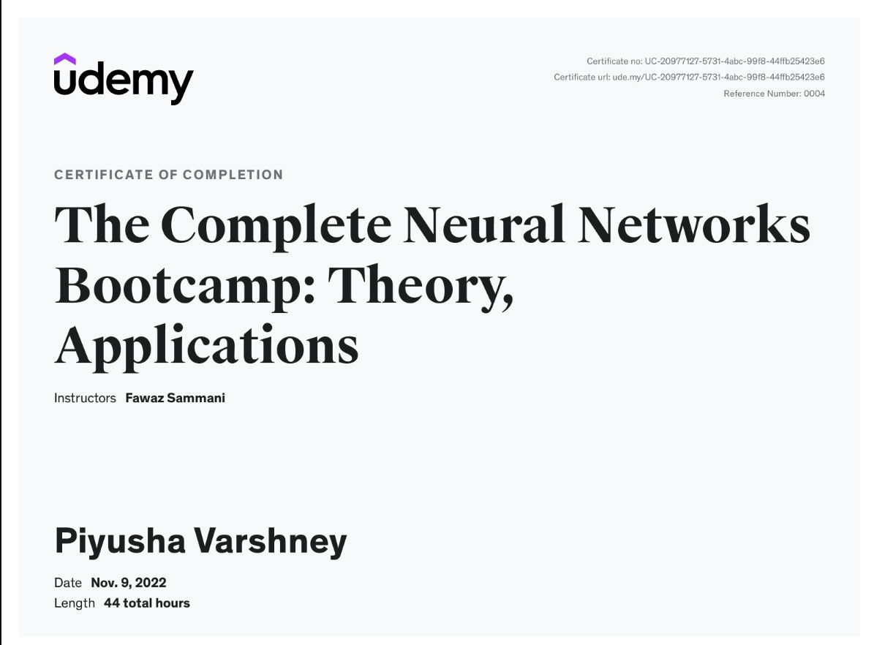
CERTIFICATION:

Slide 5
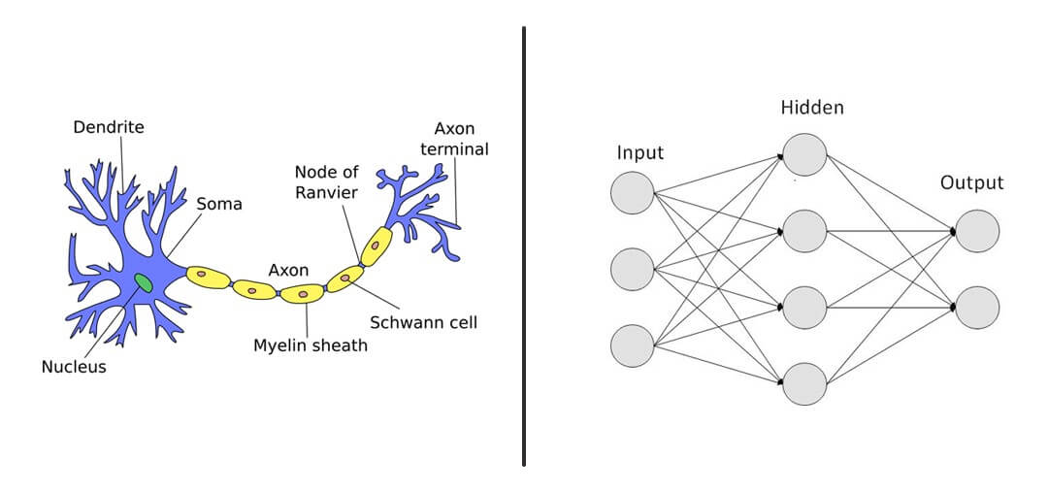
LITERATURE SURVEY
Here is the language and tools I used to make this application Hand writtren Digits.
Cuda
MNIST database
Neural Network
pyTorch
Python
Torchvision
Notes:
https://clevertap.com/blog/neural-networks/

Slide 6
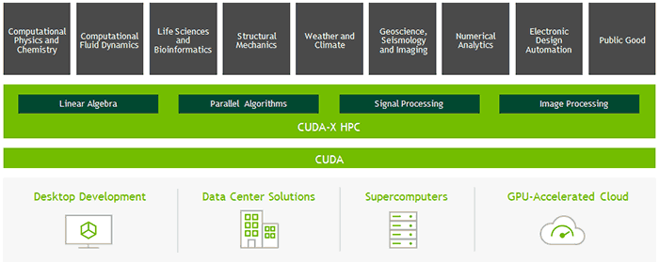
CUDA
It stands for Compute Unified Device Architecture.
CUDA is a parallel computing platform and programming model developed by NVIDIA for general computing on its own GPUs (graphics processing units). CUDA enables developers to speed up compute-intensive applications by harnessing the power of GPUs for the parallelizable part of the computation.
In very simple language Cuda is graphics processing unit (GPU), as a specialized computer processor, addresses the demands of real-time high-resolution 3D graphics compute-intensive tasks.

Slide 7
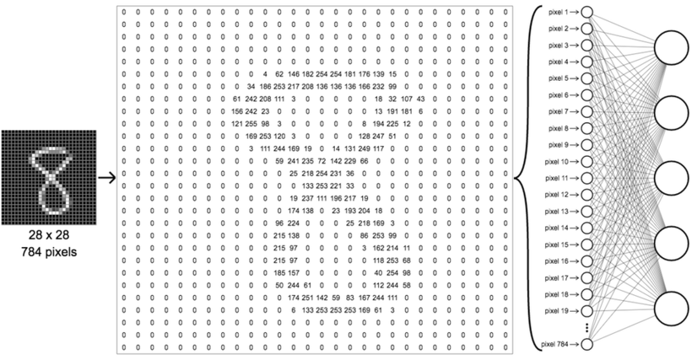
MNIST Database
The training set has 60,000 samples, while the test set contains 10,000 examples in the MNIST database of handwritten digits.
The digits have been centered in a fixed-size picture and size-normalized.
It have Special Database 3 and Special Database 1 were combined to create the MNIST database.
30,000 patterns from SD-1 and 30,000 patterns from SD-3 make up the MNIST training set. There were about 60,000 pattern training set.
5,000 patterns from SD-3 and 5,000 patterns from SD-1 made up our test set .
The digit images in the MNIST set were originally selected and experimented with by Chris Burges and Corinna Cortes using bounding-box normalization and centering.
Notes:
[1]::
train-images-idx3-ubyte.gz: training set images (9912422 bytes) train-labels-idx1-ubyte.gz: training set labels (28881 bytes) t10k-images-idx3-ubyte.gz: test set images (1648877 bytes) t10k-labels-idx1-ubyte.gz: test set labels (4542 bytes)

Slide 8
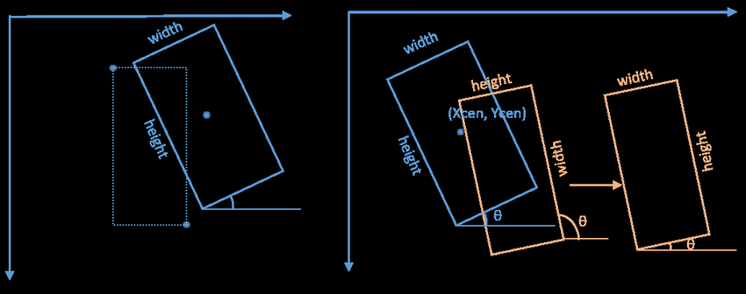
using bounding-box normalization
Normalized(Xmin) = (Xmin+w/2)/Image_Width
Normalized(Ymin) = (Ymin+h/2)/Image_Height
Normalized(w) = w/Image_Width
Normalized(h) = h/Image_Height
It will resize our images and bounding boxes for us , so we don't have to worry about that. By default, it will resize the longest side to 640px and the shortest side will be resized to a length that preserves the proportion of the original image.

Slide 9
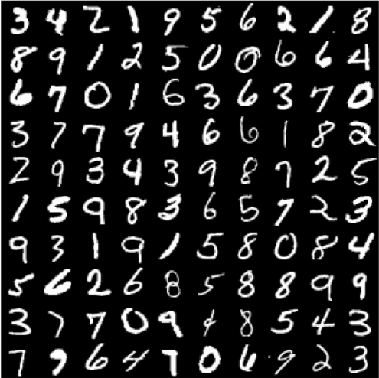
MNIST is a dataset of handwritten digits, containing 60,000 training images and 10,000 testing images. All images are in grayscale, each with a size of 28x28. In this section, we will build a Feed Forward Neural Network to classify an input image of handwritten digits from 0-9.

Slide 10
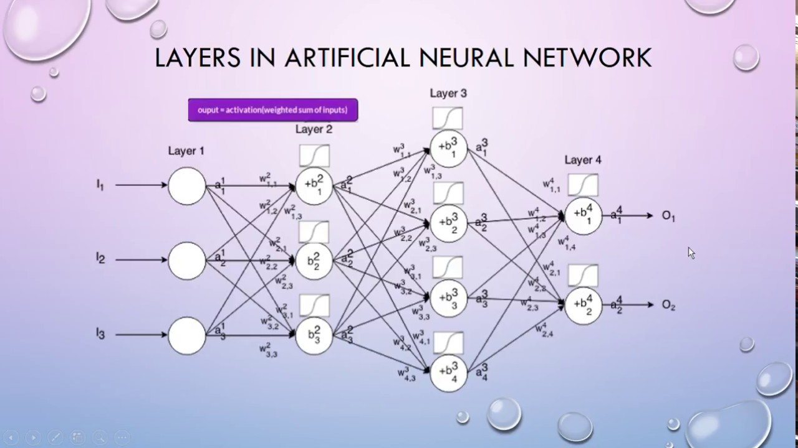
Neural Network
A neural network is a series of algorithms that endeavors to recognize underlying relationships in a set of data through a process that mimics the way the human brain operates. In this sense, neural networks refer to systems of neurons, either organic or artificial in nature.
Neural networks can adapt to changing input; so the network generates the best possible result without needing to redesign the output criteria. The concept of neural networks, which has its roots in artificial intelligence, is swiftly gaining popularity in the development of trading systems.

Slide 11


Key points:
Neural networks are a set of algorithms that simulate how an animal brain operates in order to find connections among enormous volumes of data.As a result, they frequently mirror the synapses and connections between neurons seen in the brain.
They are employed in a range of financial services applications, including forecasting, market research, fraud detection, and risk assessment.
Deep learning algorithms use neural networks that have multiple process layers, or "deep" networks.
The effectiveness of neural networks for predicting stock market price

Slide 12
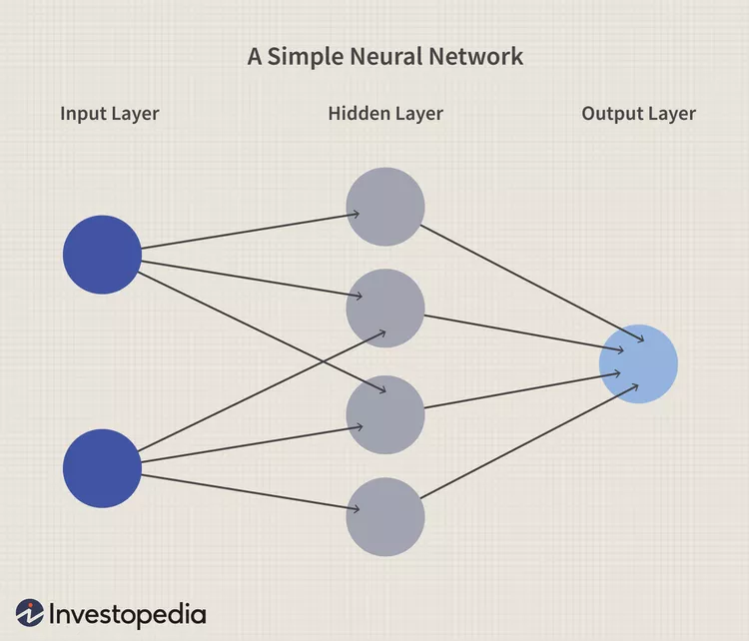
A neural network works similarly to the human brain’s neural network. A “neuron” in a neural network is a mathematical function that collects and classifies information according to a specific architecture. The network bears a strong resemblance to statistical methods such as curve fitting and regression analysis.
A neural network contains layers of interconnected nodes. Each node is a known as perceptron.
Neural networks have three main components. First, the input is the data entered into the network that is to be analyzed. Second, the processing layer utilizes the data to formulate an expected outcome. That outcome is the third component, and this third component is the desired end product from the analysis.

Slide 13
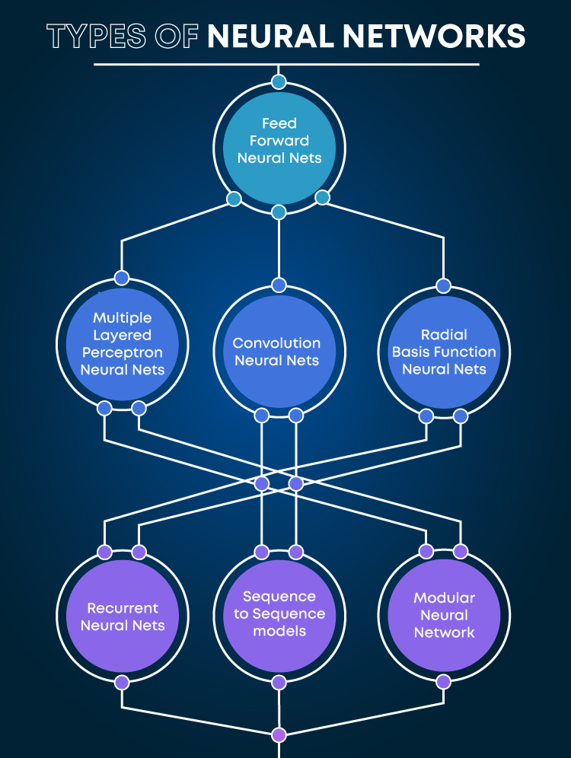
Feed-Forward Neural Networks
(I used for this application)

Slide 14
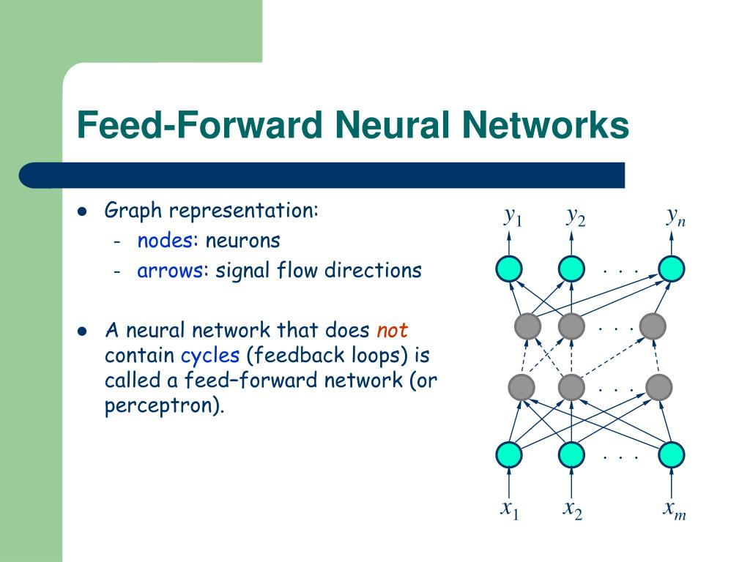
One of the simpler varieties of neural networks is the feed-forward network. Through input nodes, it transmits information in a single direction, processing it in this manner until it reaches the output mode. The type of feed-forward neural networks most frequently employed for facial recognition technology may include hidden layers for functioning.

Slide 15
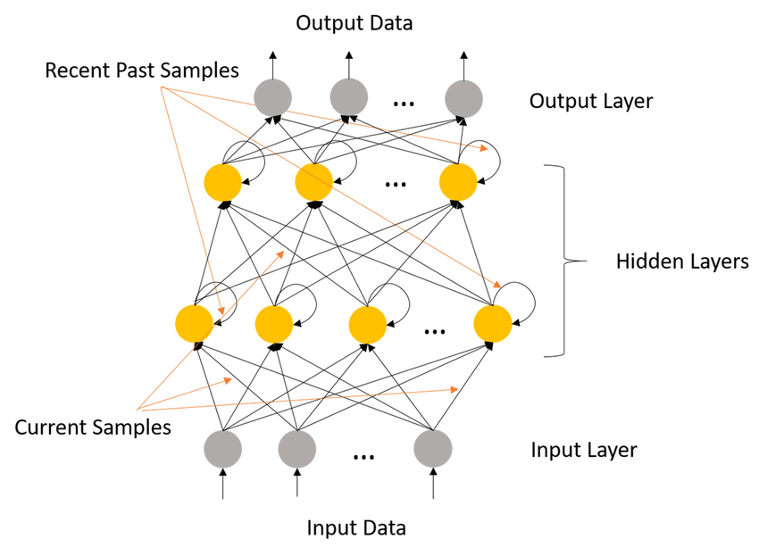
Recurrent Neural Networks
Recurrent neural networks take the output of a processing node and feed it back into the network, making it a more complicated sort of neural network. This causes theoretical "learning" and network enhancement. Each node keeps a record of previous operations, which are later utilised while processing data.
This is crucial for networks if the forecast is wrong since the system will try to figure out why the right thing happened and adjust. Applications for text-to-speech are frequently utilised using this kind of neural network.

Slide 16
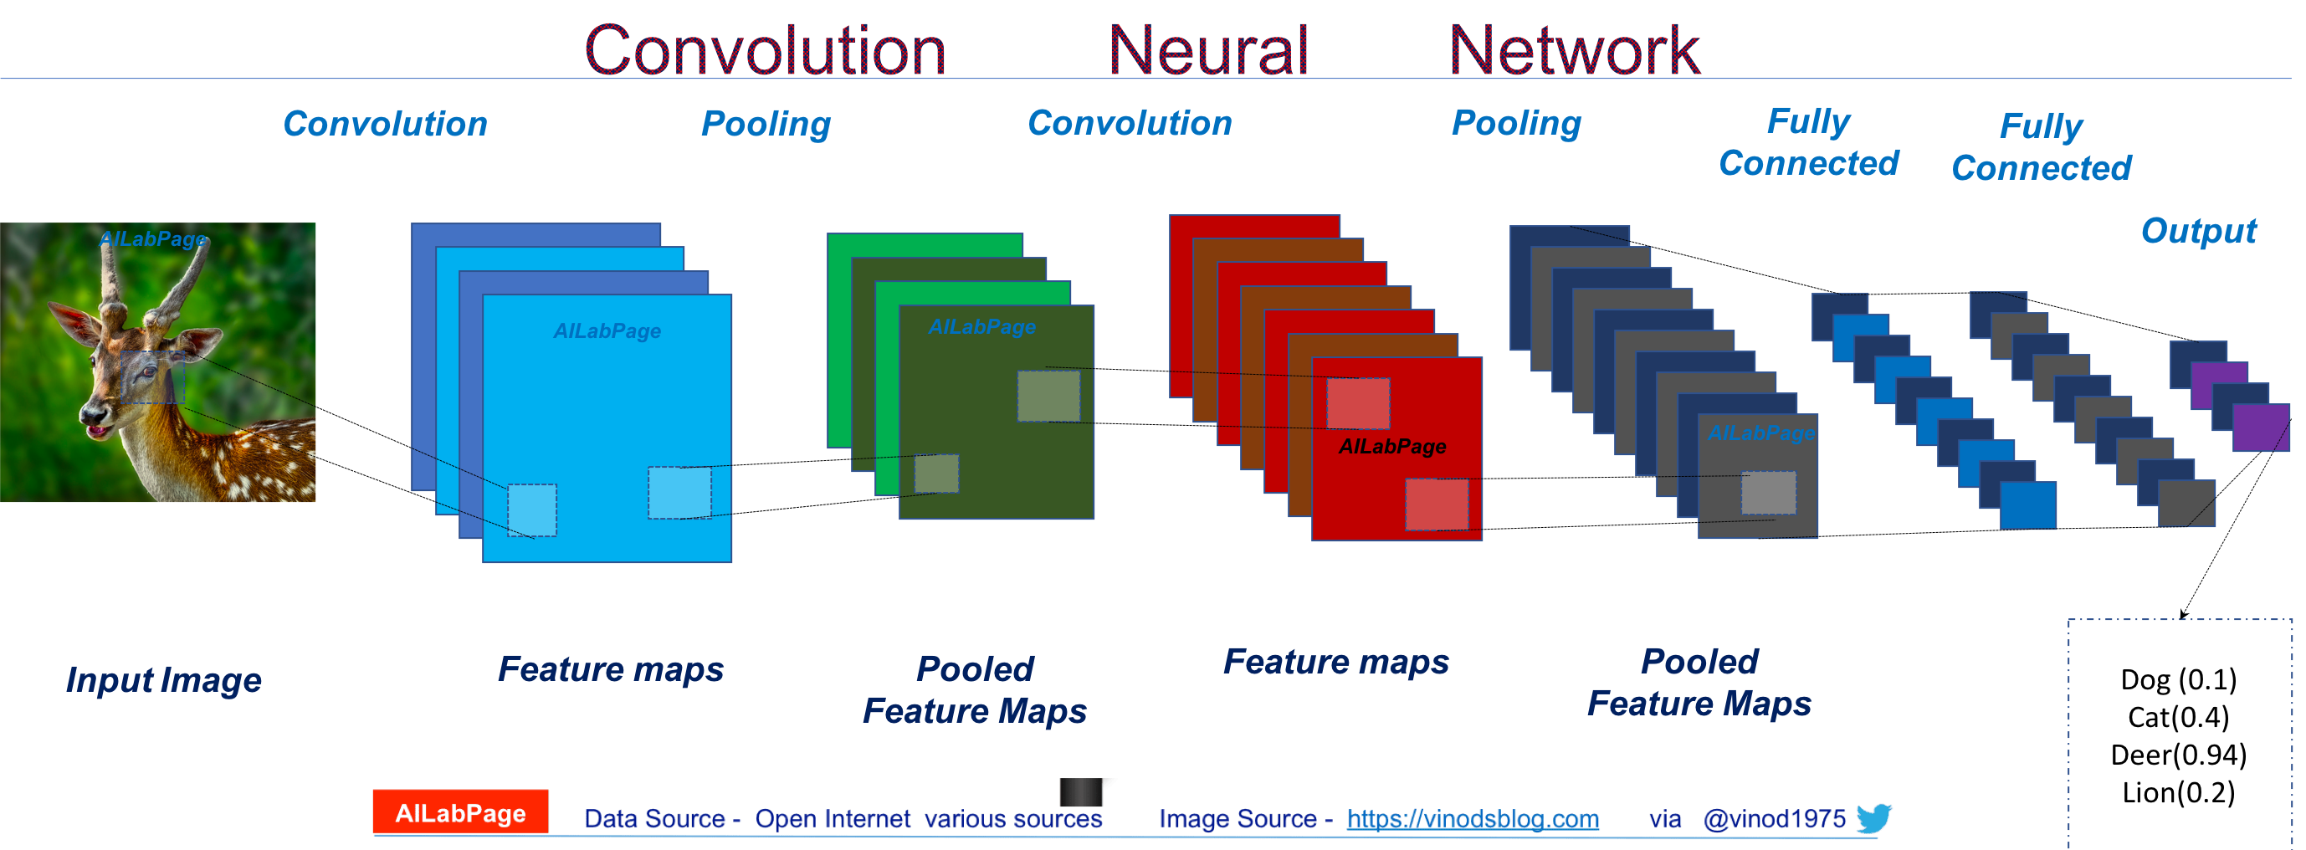
Convolutional Neural Networks
Convolutional neural networks, commonly known as ConvNets or CNNs, have a number of layers where categories of input are sorted into. These networks have an input layer, an output layer, and a slew of convolutional layers in between. The layers provide feature maps that catalogue regions of an image that are further subdivided until they produce useful outputs. These networks are very useful for applications involving image recognition because these layers can be combined or connected fully.

Slide 17

De-Convolutional Neural Networks
Convolutional neural networks operate normally, whereas deconvolutional neural networks operate the opposite. The network's use is to find things that a convolutional neural network might have classified as significant. During the convolutional neural network execution phase, these objects would have most likely been eliminated. For image processing or analysis, this kind of neural network is also frequently utilised.

Slide 18
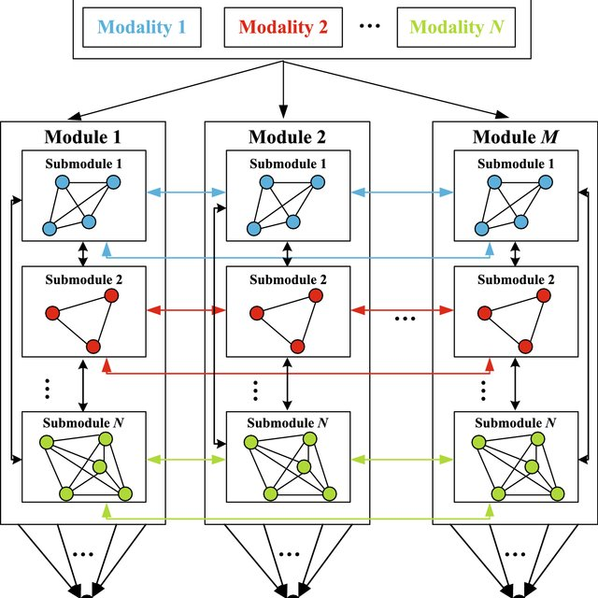
Modular Neural Networks
Multiple networks that operate independently of one another are included in modular neural networks. During an analytic procedure, these networks don't communicate with one another. Instead, these procedures are carried out to improve the effectiveness of intricate, complex computing procedures. The objective of the network independence is to have each module responsible for a certain component of an overall greater picture, similar to other modular sectors like modular real estate.

Slide 19

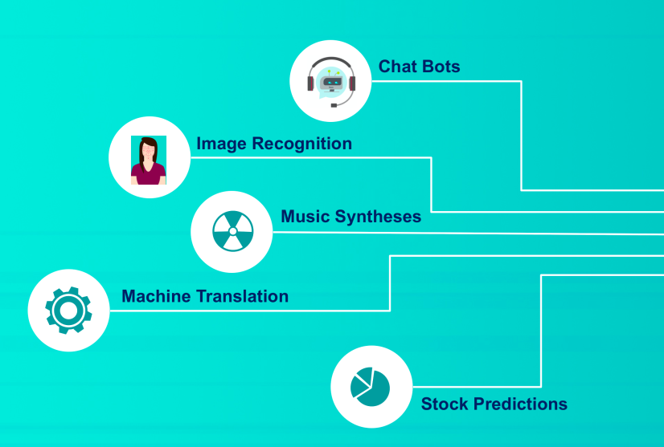
Neural Networks
Pros
Cons
Can often work more efficiently and for longer than humans
Can be programmed to learn from prior outcomes to strive to make smarter future calculations
Often leverage online services that reduce (but do not eliminate) systematic risk
Are continually being expanded in new fields with more difficult problems
Still rely on hardware that may require labor and expertise to maintain
May take long periods of time to develop the code and algorithms
May be difficult to assess errors or adaptions to the assumptions if the system is self-learning but lacks transparency
Usually report an estimated range or estimated amount that may not actualize.

Slide 20
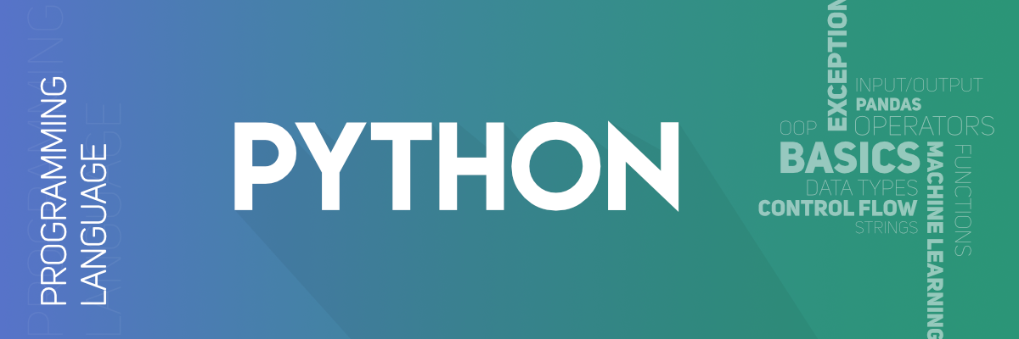
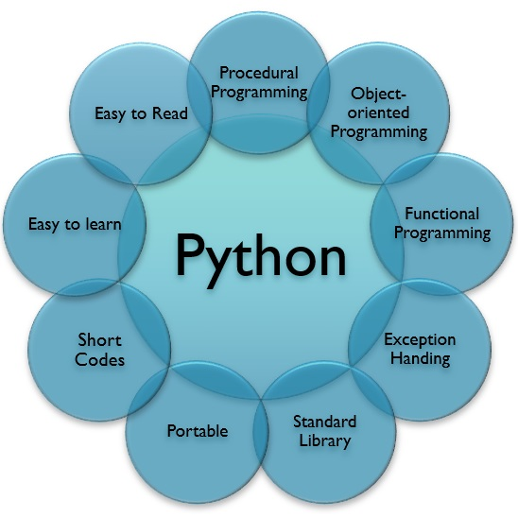
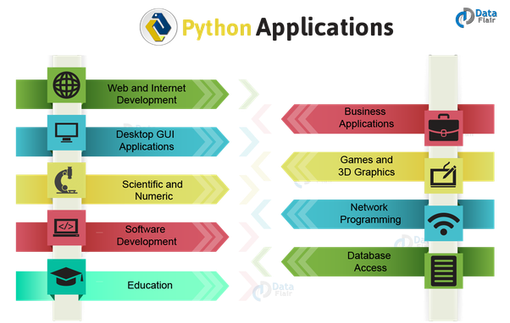
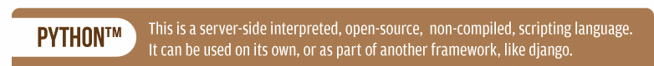
Notes:
wikipedia

Slide 21
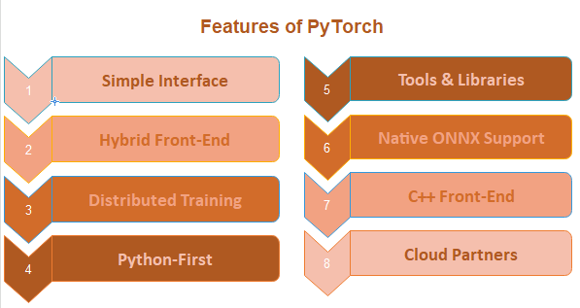

PyTorch
Python and the Torch library are the foundation of PyTorch, an open source machine learning (ML) framework.
One of the most popular platforms for deep learning research is this one. The framework is designed to accelerate the transition from research prototyping to implementation.
It quickens the process from research prototyping to deployment in the marketplace.

Slide 22
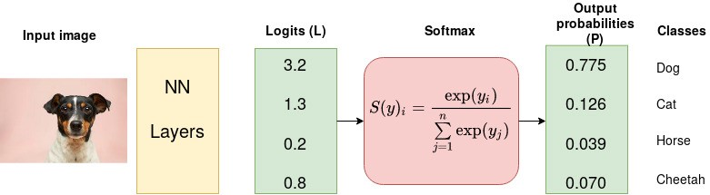
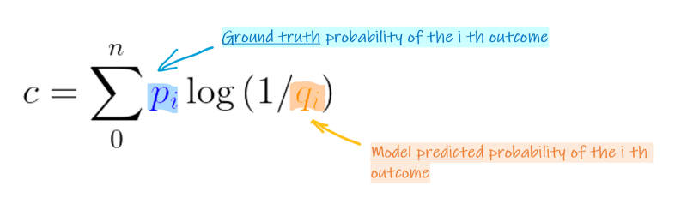
CROSSENTROPYLOSS
This criterion computes the cross entropy loss between input logits and target.
It is useful when training a classification problem with C classes. If provided, the optional argument weight should be a 1D Tensor assigning weight to each of the classes. This is particularly useful when you have an unbalanced training set.

Slide 23
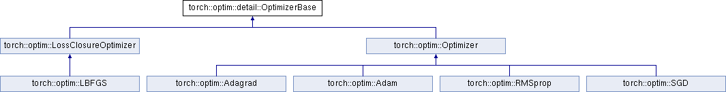
TORCH.OPTIM
torch.optim is a package implementing various optimization algorithms. Most commonly used methods are already supported, and the interface is general enough, so that more sophisticated ones can be also easily integrated in the future.
To use torch.optim you have to construct an optimizer object, that will hold the current state and will update the parameters based on the computed gradients.
I use one of the algorithm ADAM cause is the data is very unbalanced and it gives very good optimization on these kind of datasets.

Slide 24
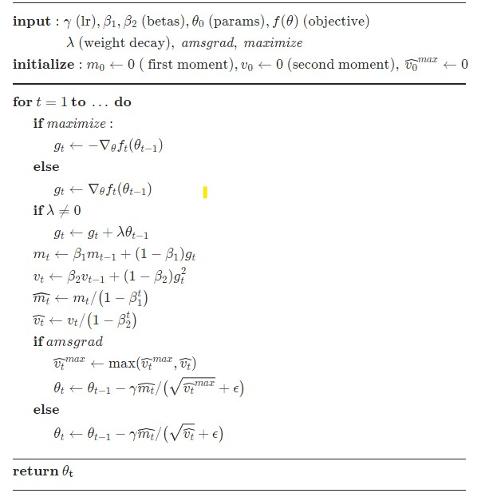
Implements Adam algorithm.

Slide 25
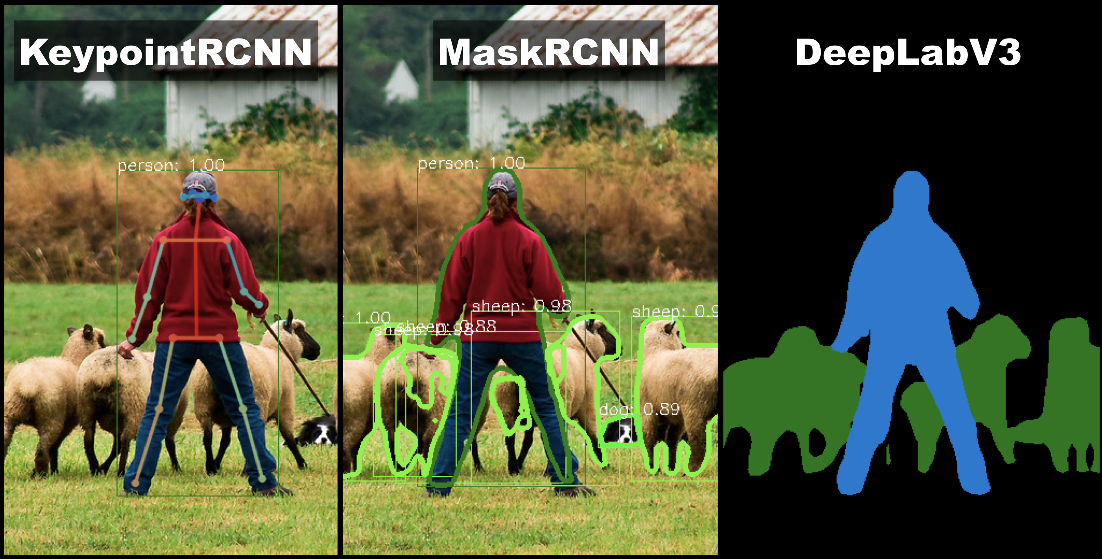
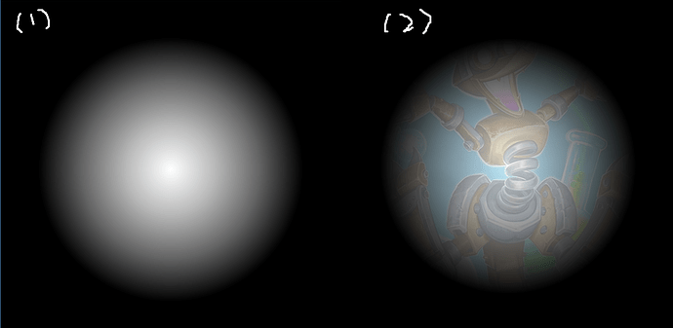
TorchVision
Torchvision is a computer vision library that works in tandem with PyTorch. There are tools for quick image and video conversions, pre-trained models that are widely used, and datasets ( torchvision does not come bundled with PyTorch , you will have to install it separately. )

Slide 26
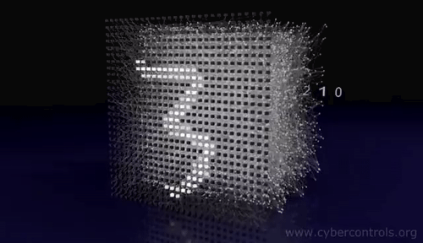
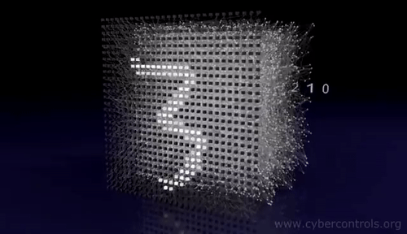
INTRODUCTION TO PROJECT
SO…..HERE THE PROJECT START
As I previously discussed about all the things used in my project so for a short review let me take you the names which I mentioned and used for my project
Cuda
MNIST database
Feed-Forward Neural Network
pyTorch
Python
Torchvision
CrossEntropyLoss

Slide 27
WHY THIS PROJECT HAS BEEN CHOSEN?
This project is chosen cause it comes under my area of interest .
I am always their in in question of why? and how? So these neural networks gave me question of my answers(hypothetically)
But the main reason too pick this course is too directly excel in the field of data science which is very vast field in its own , I think this is my very initial step on to entering the field of data
As data is available everywhere but how too use it can done by an trainer in felid of data. So that data can be used for upcoming technology and make our work more easier.

Slide 28
PROJECT MODULES
Project module is
importing the libraries , packages required
Initialization of the parameters used in the project (they are 6 parameters )
Importing / training of MNIST dataset.
Loading of Dataset in NN.
Network class .
Creation of object which will represent our class.
Train the network
LOSS Function
Optimizer
Predicted image
Accuracy score(98.01%)

Slide 29
FEASIBILITY STUDY
An executive summary which is describing the project's overall viability
After execution the accuracy score is 98.01% (in which I only tried FNN it can be increased by CNNs ).
Service being developed during this project.
The project is train and will predict the handwriting in the dataset is handwritten or typed . As NIST originally designated SD-3 as their training set and SD-1 as their test set. However, SD-3 is much cleaner and easier to recognize than SD-1. The reason for this can be found on the fact that SD-3 was collected among Census Bureau employees, while SD-1 was collected among high-school students.
Technical considerations
You should have knowledge about Python , Pytorch .

Slide 30
REQUIREMENT SPECIFICATION
For this project you need: (A laptop supporting GPU prefrable)
Anaconda Prompt
CUDA
Pytorch
Troch Vision
Jupyter Notebook
Command on Python
MNIST dataset
Epochs no.(how many time we pass our data set on NN while Training)

Slide 31
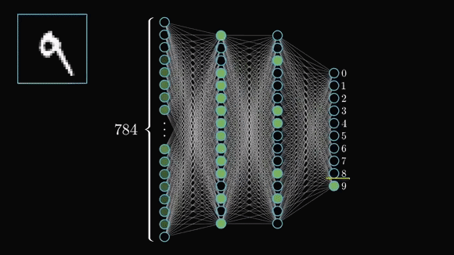
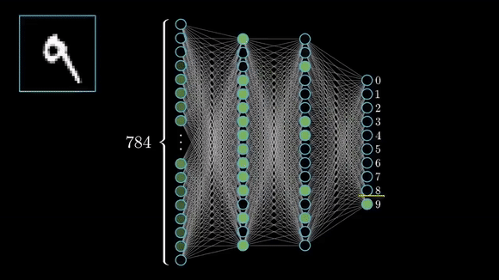
SYSTEM DESIGN

Slide 32
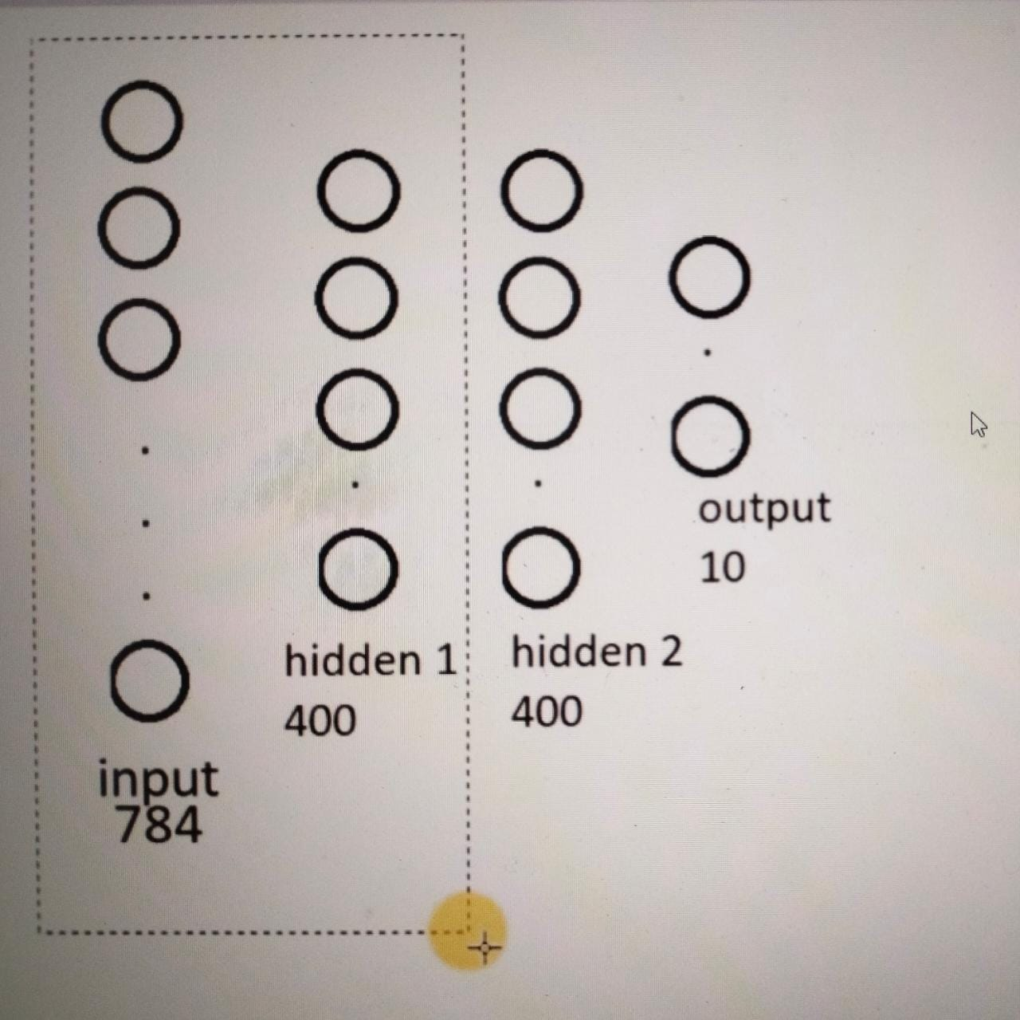
SNAPSHOT FOR TRAINING
PHASE 1:

Slide 33
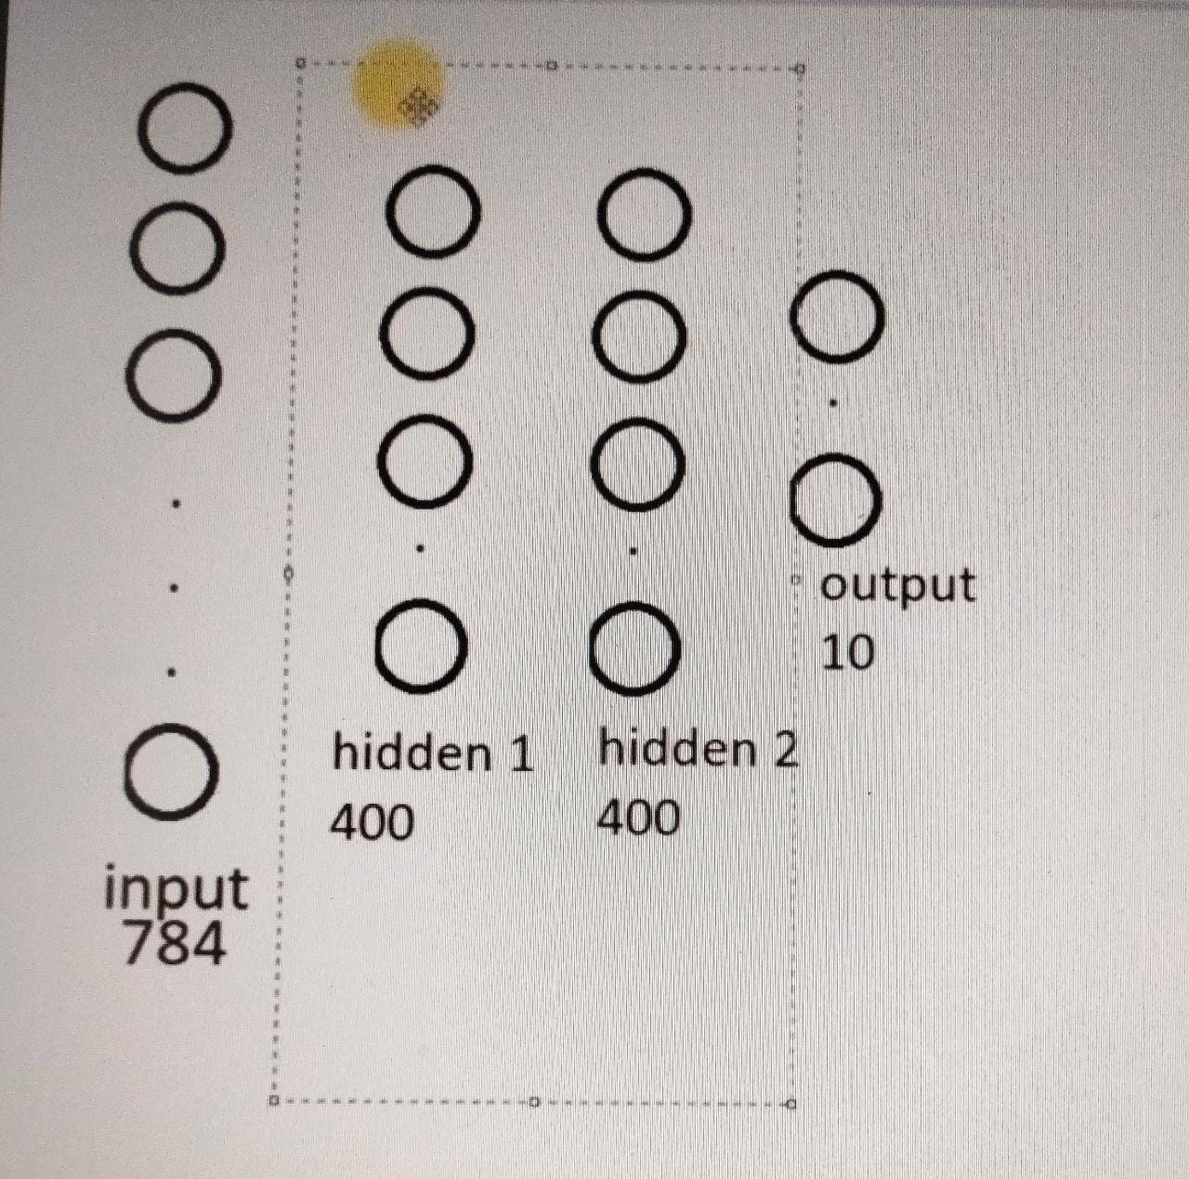
Phase 2 :

Slide 34
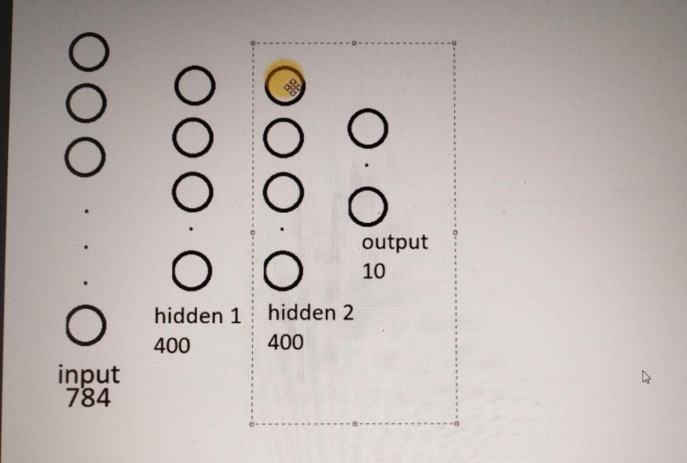
Phase 3:

Slide 35
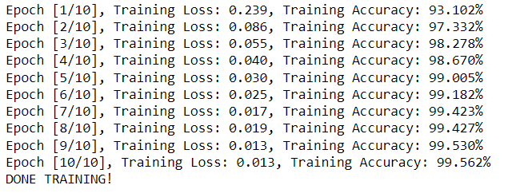
TRAINING SNAPSHOT :

Slide 36
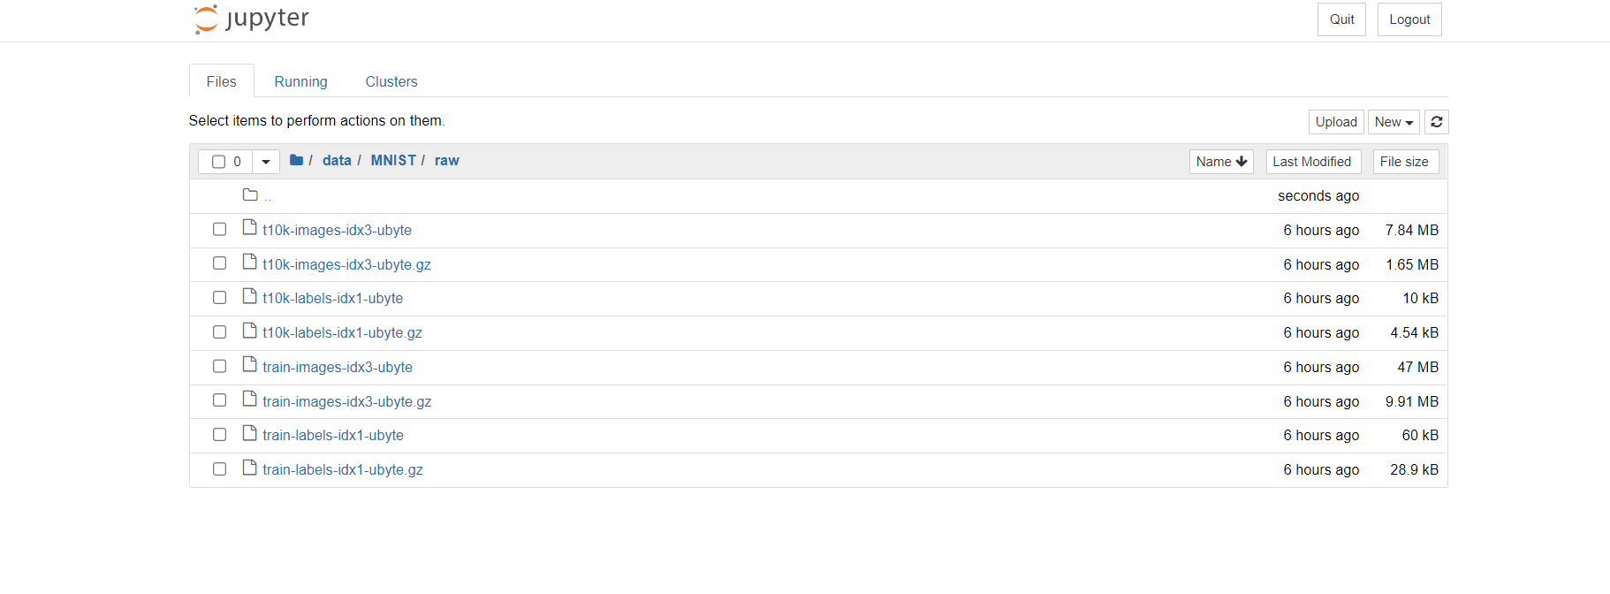
Dataset Snapshot

Slide 37

PIYUSHA VARSHNEY
(IT IIIrd YR)
2000640130006

